Slide 1
SECURING VEHICULAR NETWORK IN SMART VEHICLES USING BLOCKCHAIN
- TEAM 3
2019506010
2019506008
2019506083
2019506087
2019506097

Slide 2
OBJECTIVE AND SCOPE
Objective:
To produce a framework for in-vehicle network security that exposes threats in smart vehicles (CAVs) by ascertaining the state of the vehicles internal controls.
Scope of the project:
To build a decentralized security framework for in-vehicle networks
To evaluate the resilience of the proposed framework to identified attacks
To detect Distributed Denial of Service (DDoS) attack using Machine Learning

Slide 3
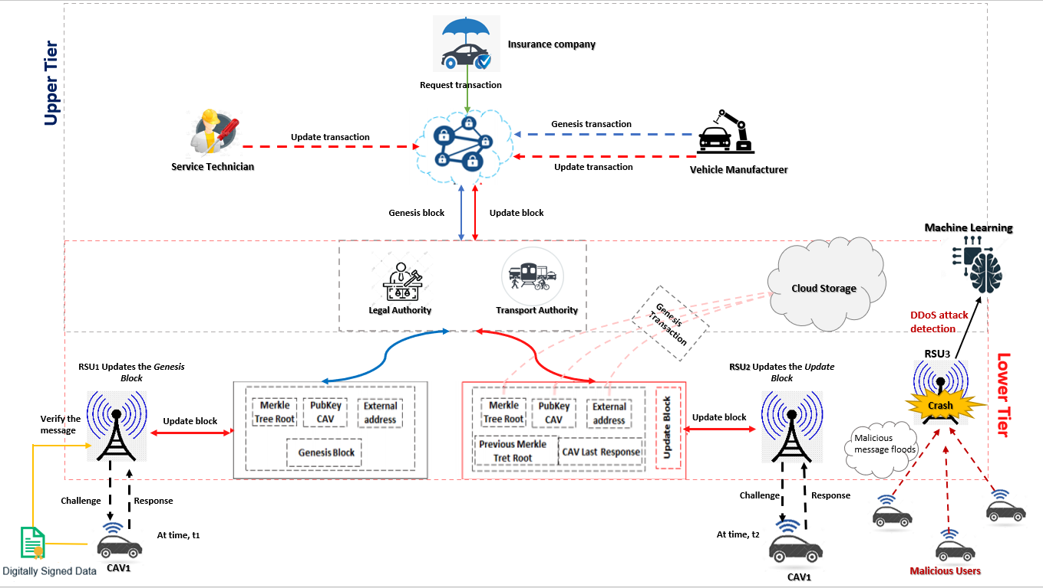
ARCHITECTURE DIAGRAM

Slide 4
MODULES IMPLEMENTED
Registration of CAV
Challenge-Response Mechanism
Updation of CAV
Authenticating messages using Digital Signature
Detection of DDoS Attacks in VANETS using Machine Learning

Slide 5
OUTCOME
A model which exploits the blockchain framework to provide security for smart vehicles
Identifying malicious CAVs by detecting any comprise in the internal state of the CAV
A Machine Learning model to detect DDoS attacks in VANETS

Slide 6
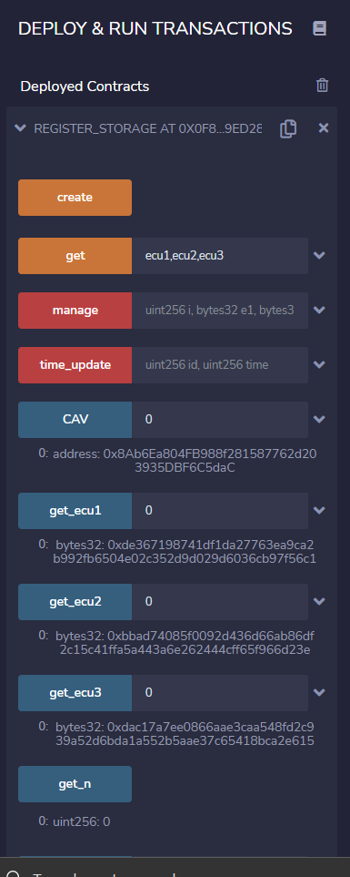
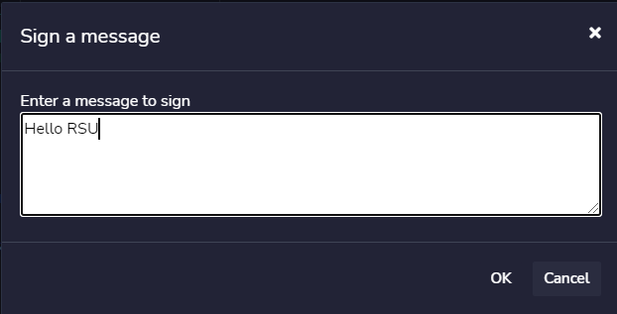
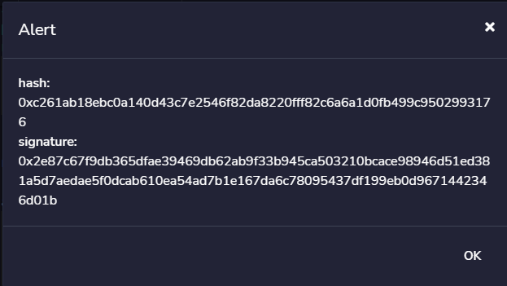
RESULT

Slide 7
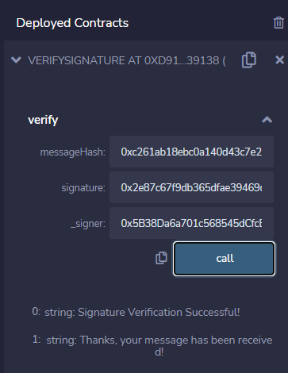
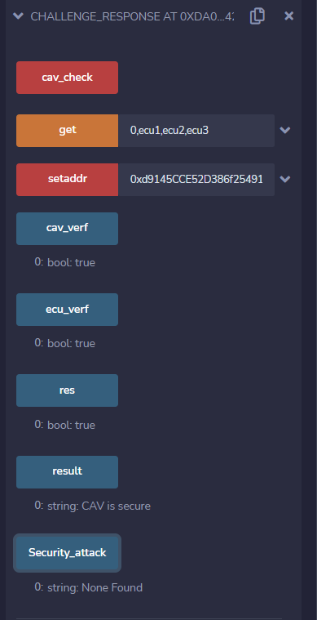
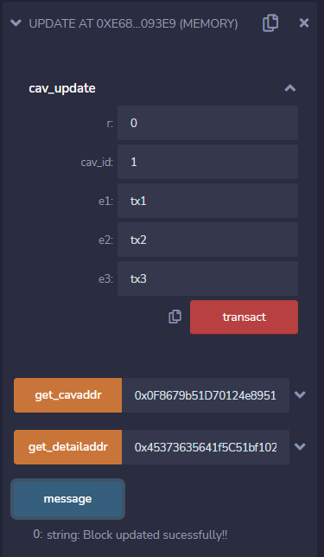

Slide 8
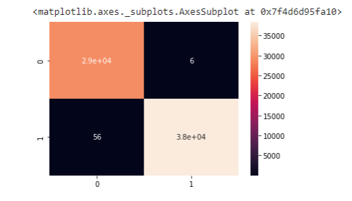
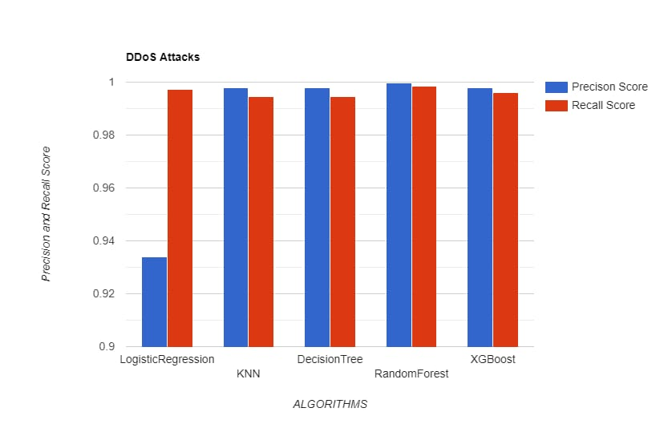

Slide 9
THANK YOU

